Slide 1
OmniRetail Sales SQL Analysis
By: SAMUEL ADEBAYO
Date: 2nd July, 2024

Slide 2


Creating DataBase
STEP 1

Slide 3
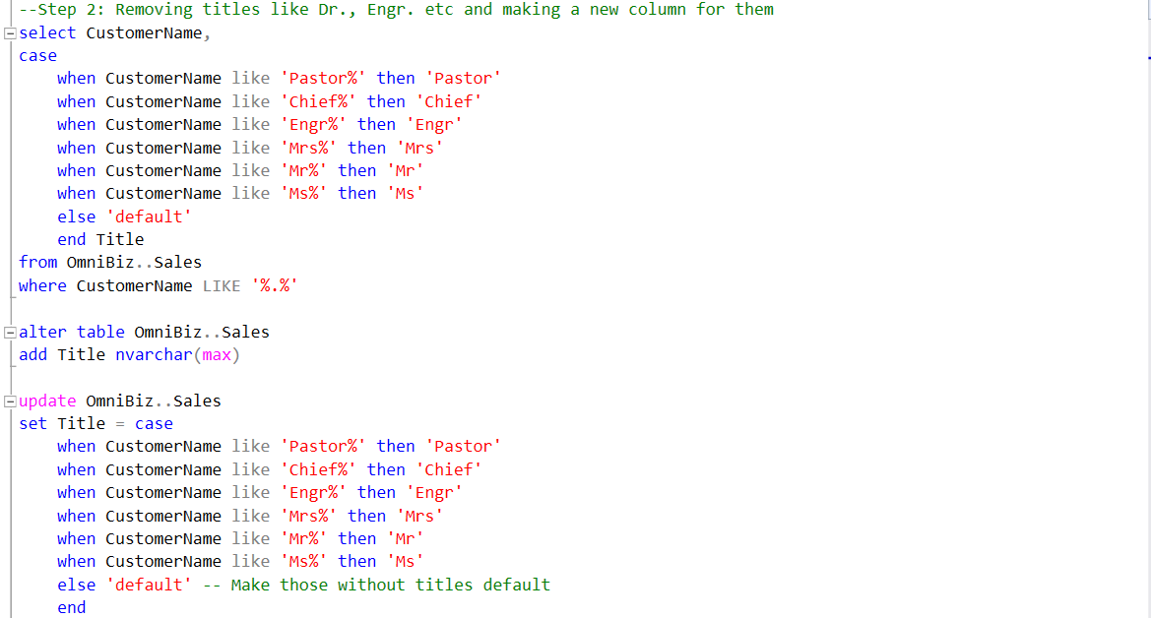
STEP 2 – Title Column

Slide 4
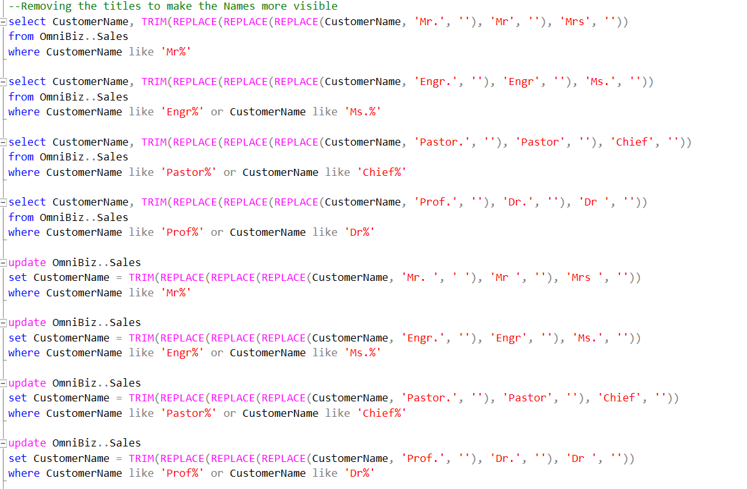
Step 2 – Title Removal

Slide 5
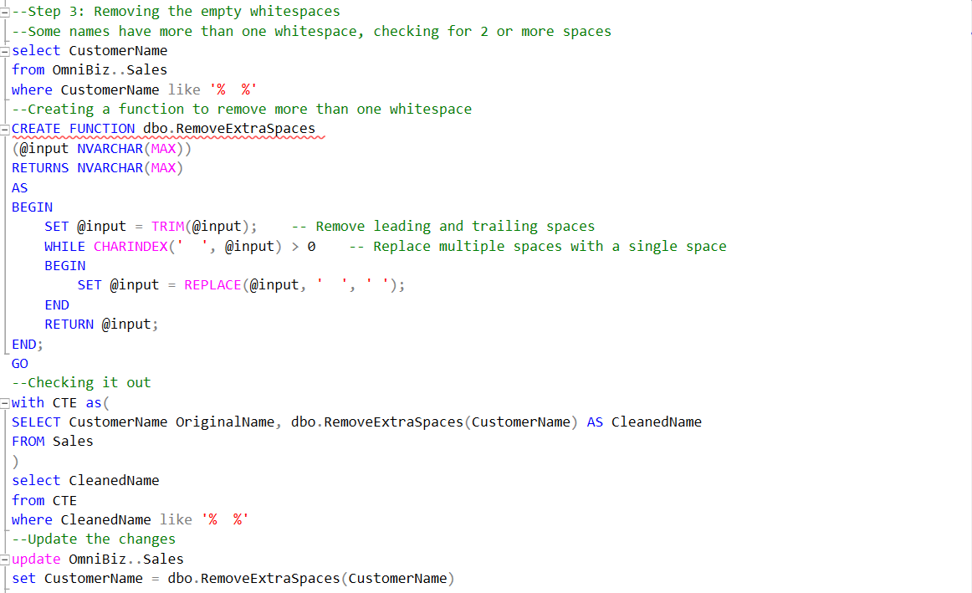
Step 3 – Empty space removal

Slide 6
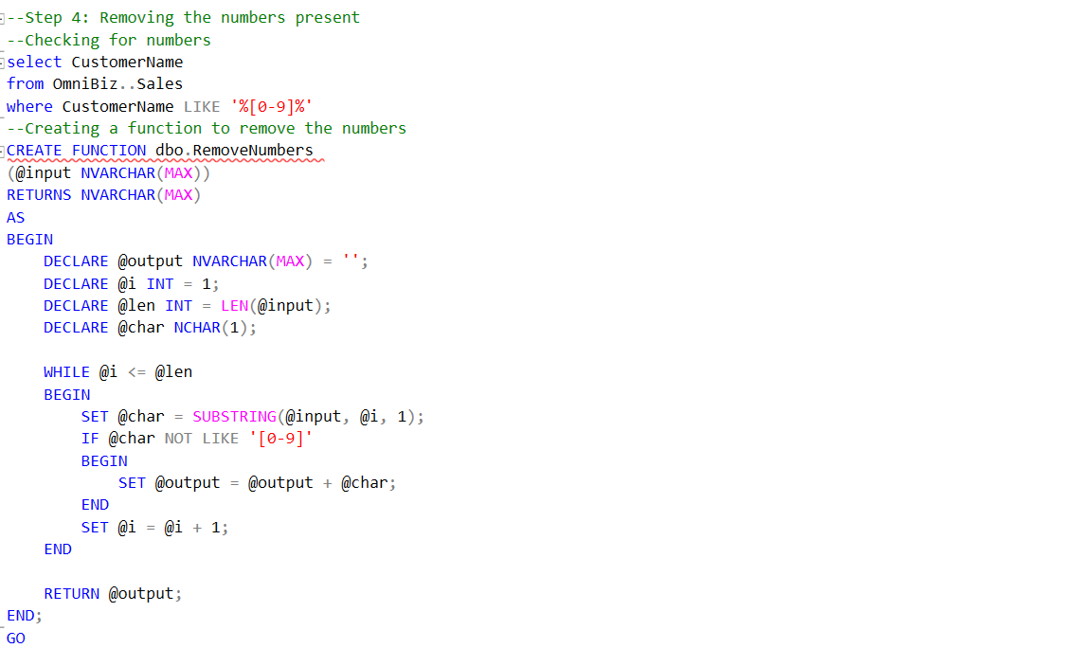

Step 4 – Number removals

Slide 7
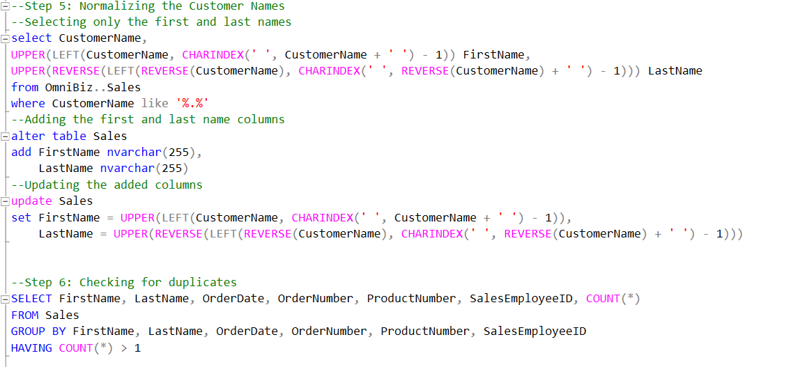
Step 5 and 6

Slide 8

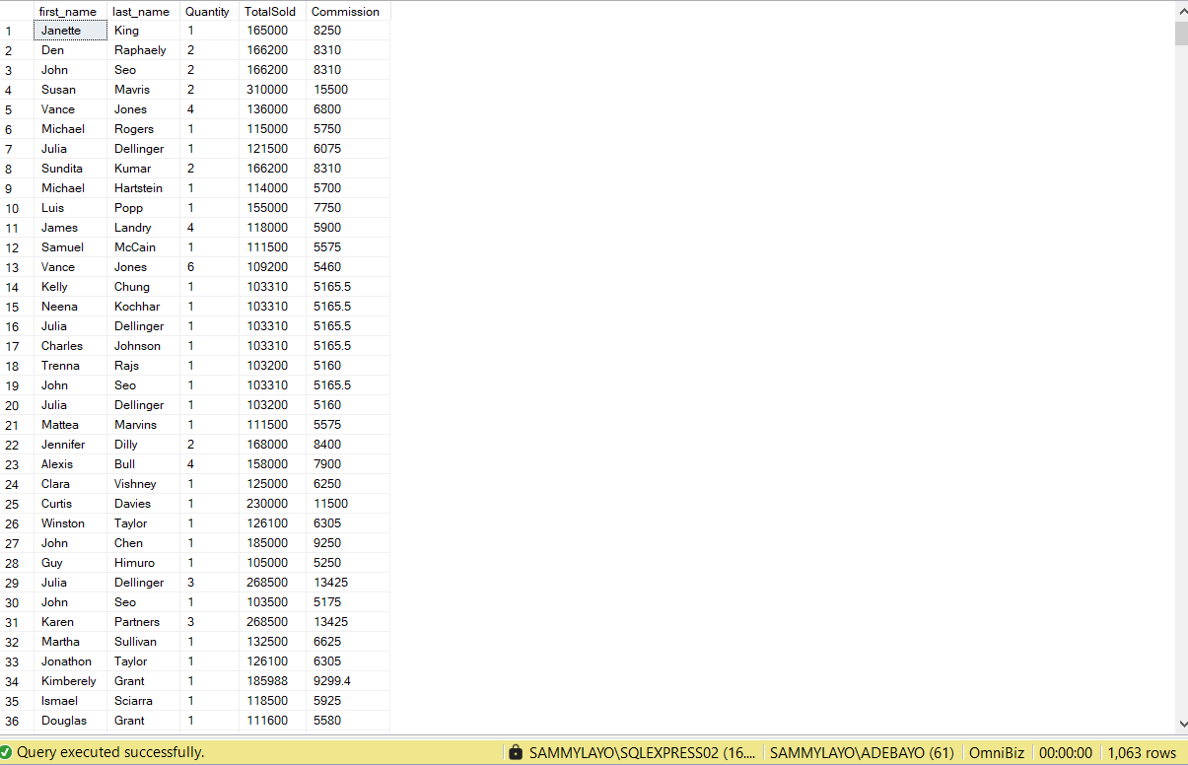
Question 1

Slide 9
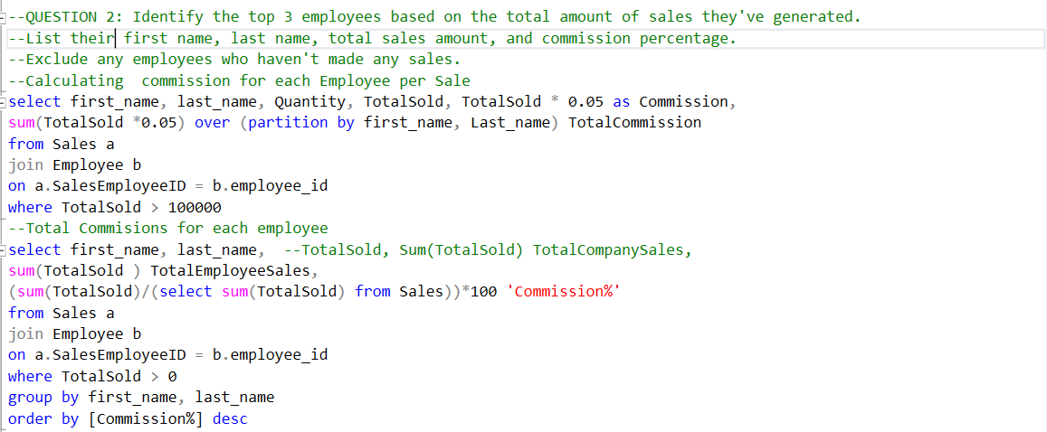
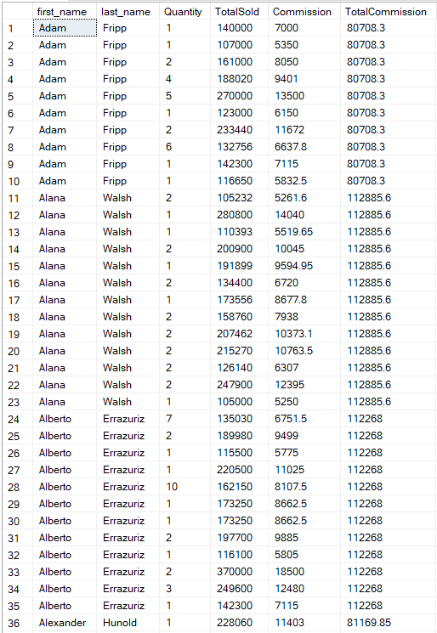
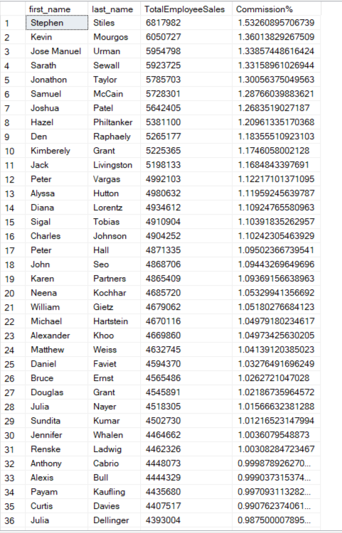
Question 2

Slide 10


Question 3

Slide 11


Question 4

